Slide 1

Database Management Systems Cornerstone Project
Final Review (Review II)
Presented by
D. Srinivas (25B11AID13)
Ch. Sashank (26B21AI018)
T. Praveen (25B11AIC12)
Department of Artificial Intelligence & Machine Learning

Slide 2




Presentation Outline
ABSTRACT
Our Library Management System uses a relational database to manage users, books, physical copies, libraries, racks, borrowing and transfers.
Review II focuses on implementation: table creation, constraints, sample data, SQL operations, CRUD, joins, aggregate queries, views, validation and documentation.
PRESENTATION OUTLINE
• Project design & problem statement
• Entities, attributes & ER diagram
• Relational schema & keys
• GitHub repository & team
• Database & constraints
• Sample data
• DDL, DML & DQL
• CRUD, joins, aggregates & views
• Data integrity & validation
• Documentation & demonstration
• Conclusion

Slide 3
PROJECT TITLE, OBJECTIVES & PROBLEM
Title: Library Management System
Problem:
• Tracking books, copies, locations and borrowing manually is difficult.
• A quantity-only system cannot identify the exact physical copy.
Objectives:
• Maintain book and user records.
• Track physical copies using unique barcodes.
• Manage borrowing, returns and locations.
• Provide reliable SQL search and reports.

Slide 4
ENTITIES & ATTRIBUTES
DESIGN
Our Library Management System contains the following main entities:
Entity | Important Attributes
1. USER | User_ID, Name, Email, Phone, User_Type
2. AUTHOR | Author_ID, Author_Name, Biography
3. BOOK | Book_ID, Title, ISBN, Category, Publisher
4. BOOK_COPY | Copy_ID, Book_ID, Library_ID, Rack_ID, Status
5. LIBRARY | Library_ID, Library_Name, Location, Contact
6. RACK | Rack_ID, Library_ID, Rack_Number, Section

Slide 5
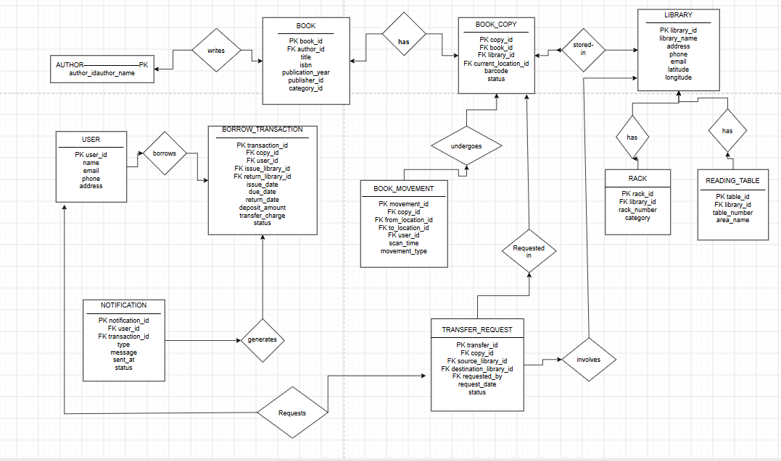
ER DIAGRAM
DESIGN

Slide 6
RELATIONAL DATABASE SCHEMA
DESIGN
USER(User_ID PK, Name, Email, Phone, User_Type)
AUTHOR(Author_ID PK, Author_Name, Biography)
BOOK(Book_ID PK, Title, ISBN, Category, Publisher, Author_ID FK)
BOOK_COPY(Copy_ID PK, Book_ID FK, Library_ID FK, Rack_ID FK, Status)
LIBRARY(Library_ID PK, Library_Name, Location, Contact)
RACK(Rack_ID PK, Library_ID FK, Rack_Number, Section)
READING_TABLE(Table_ID PK, Library_ID FK, Table_Number, Capacity)
BOOK_MOVEMENT(Movement_ID PK, Copy_ID FK, From_Rack_ID FK,
To_Rack_ID FK, Movement_Date)
BORROW_TRANSACTION(Transaction_ID PK, User_ID FK, Copy_ID FK,
Issue_Date, Due_Date, Return_Date)
TRANSFER_REQUEST(Transfer_ID PK, Copy_ID FK, From_Library_ID FK,
To_Library_ID FK, Request_Date, Status)
NOTIFICATION(Notification_ID PK, User_ID FK, Message, Date, Status)

Slide 7
DESIGN
PRIMARY & FOREIGN KEYS
Primary Keys uniquely identify each record.
Foreign Keys connect related tables.
Examples:
• BOOK.book_id → PK
• BOOK_COPY.copy_id → PK
• BOOK_COPY.book_id → BOOK.book_id (FK)
• BOOK_COPY.library_id → LIBRARY.library_id (FK)
• RACK.library_id → LIBRARY.library_id (FK)
• BORROW_TRANSACTION.copy_id → BOOK_COPY.copy_id (FK)
• BORROW_TRANSACTION.user_id → USER.user_id (FK)
These relationships maintain referential integrity.

Slide 8
GITHUB REPOSITORY & TEAM
DESIGN
Team responsibilities:
• D. Srinivas — Frontend / Testing & Documentation
• Ch. Sashank — Backend / SQL Implementation
• T. Praveen — Database / ER Design
Repository contents:
• SQL schema and sample data
• ER diagram and relational schema
• SQL queries and screenshots
• Project documentation
Repository Link: __________________________

Slide 9
DATABASE & CONSTRAINTS
IMPLEMENTATION
CREATE DATABASE LibraryManagement;
USE LibraryManagement;
CREATE TABLE USER (
User_ID INT PRIMARY KEY,
Name VARCHAR(50) NOT NULL,
Email VARCHAR(100) UNIQUE,
Phone VARCHAR(15) UNIQUE,
User_Type VARCHAR(20) DEFAULT 'Student',
CHECK (User_Type IN ('Student', 'Faculty', 'Staff'))
);
CREATE TABLE BOOK (
Book_ID INT PRIMARY KEY,
Title VARCHAR(100) NOT NULL,
ISBN VARCHAR(20) UNIQUE,
Category VARCHAR(50) NOT NULL,
Publisher VARCHAR(100)
);
CREATE TABLE LIBRARY (
Library_ID INT PRIMARY KEY,
Library_Name VARCHAR(100) NOT NULL UNIQUE,
Location VARCHAR(100) NOT NULL,
Contact VARCHAR(15) UNIQUE
);
);5
CREATE TABLE RACK (
Rack_ID INT PRIMARY KEY,
Library_ID INT NOT NULL,
Rack_Number INT NOT NULL,
Section VARCHAR(50) DEFAULT 'General',
CHECK (Rack_Number > 0),
FOREIGN KEY (Library_ID) REFERENCES LIBRARY(Library_ID)
);
CREATE TABLE BOOK_COPY (
Copy_ID INT PRIMARY KEY,
Book_ID INT NOT NULL,
Library_ID INT NOT NULL,
Rack_ID INT,
Status VARCHAR(20) DEFAULT 'Available',
CHECK (Status IN ('Available', 'Issued', 'Lost', 'Damaged')),
FOREIGN KEY (Book_ID) REFERENCES BOOK(Book_ID),
FOREIGN KEY (Library_ID) REFERENCES LIBRARY(Library_ID),
FOREIGN KEY (Rack_ID) REFERENCES RACK(Rack_ID)

Slide 10
SAMPLE DATA INSERTION
IMPLEMENTATION
Sample data is inserted into the main tables for testing.
Examples:
• Authors: James Clear, Yuval Noah Harari
• Books: Atomic Habits, Sapiens
• Libraries: Library A, Library B
• Copies: BC-1023, BC-1024
• Users: User-101, User-102
• Borrow transactions with issue/due/return dates
This data is used for queries, joins, reports and validation.

Slide 11
DDL, DML & DQL OPERATIONS
IMPLEMENTATION
DDL — database structure
• CREATE DATABASE / TABLE
• ALTER TABLE
DML — data manipulation
• INSERT
• UPDATE
• DELETE
DQL — data retrieval
• SELECT
• WHERE
• ORDER BY
• GROUP BY
These operations create the structure, manage records and retrieve required information.
SELECT b.title,
l.library_name
FROM BOOK b
JOIN BOOK_COPY bc
ON b.book_id=bc.book_id
JOIN LIBRARY l
ON bc.library_id=l.library_id
WHERE bc.status='Available';

Slide 12
CRUD & SQL QUERIES
IMPLEMENTATION
CRUD:
• CREATE → INSERT a new user/book
• READ → SELECT available books
• UPDATE → change copy status/location
• DELETE → remove a test record
Other SQL features:
• JOINs for related tables
• COUNT / SUM / AVG for reports
• VIEW for reusable results
• WHERE, GROUP BY, HAVING and ORDER BY
SELECT library_id,
COUNT(*) AS copies
FROM BOOK_COPY
GROUP BY library_id;
CREATE VIEW available_books AS
SELECT * FROM BOOK_COPY
WHERE status='Available';

Slide 13
DATA INTEGRITY & VALIDATION
IMPLEMENTATION
Validation checks:
• No duplicate primary IDs.
• Barcode values remain unique.
• Required fields cannot be NULL.
• Foreign keys must reference existing records.
• Status and date values are validated.
• Invalid records are rejected by constraints.
Example: BOOK_COPY cannot reference a non-existing BOOK or LIBRARY.

Slide 14
IMPLEMENTATION
PROJECT DOCUMENTATION

Slide 15
DEMONSTRATE & PRESENT
IMPLEMENTATION
Demonstration flow:
1. Open the Library Management database.
2. Show tables and constraints.
3. Insert and view sample records.
4. Run SELECT and JOIN queries.
5. Demonstrate CRUD operations.
6. Show aggregate query / view output.
7. Demonstrate validation using duplicate or invalid data.
Final result: structured storage and retrieval of library information.

Slide 16
CONCLUSION
The project combines the database design from Review I with Review II implementation.
Key learnings: relational modeling, keys and constraints, SQL operations, CRUD, joins, aggregate queries and data validation.
Future enhancements: barcode scanning, multi-library search, wrong-rack alerts and transfer tracking.

Slide 17
THANK YOU

